Slide 1


SVM Based Oversampling Technique for Imbalanced Dataset
UNIVERSITY OF HERTFORDSHIRE

Slide 2

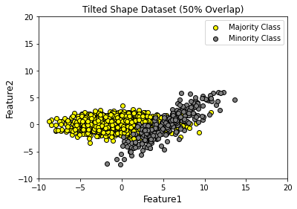
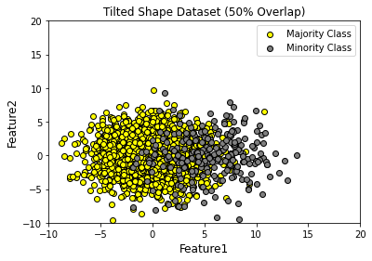
Class Imbalance
This problem is extremely common in practice and can be observed in various disciplines including
fraud detection,
anomaly detection,
Customer churn prediction,
Disease diagnosis,
Spam Email Detection, etc.

Slide 3
Problem Statement
Most machine learning algorithms work best when the number of instances of each class are roughly equal. When the number of instances of one class far exceeds the other, class imbalance problem arises.

Slide 4
Sampling on Imbalance Datasets
Over-Sampling
Under-Sampling
Notes:
To resolve this issue using Sampling method

Slide 5
Over-Sampling
Synthetic Minority Oversampling Technique (SMOTE)
Adaptive Synthetic Sampling Approach (ADASYN)

Slide 6
SVM Over-Sampling
Grid
Grid Search (C and Gamma)
Create
Create new points using NumPy library
Measure
Measure the distance of newly generated points from Hyperplane
Oversample
Save the respective oversampled points
Generate
Generate Decision Boundary

Slide 7
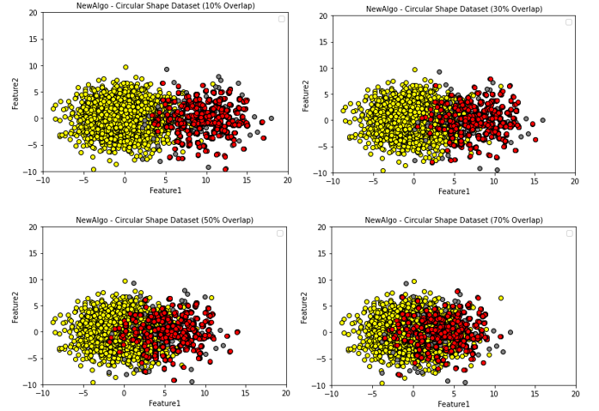
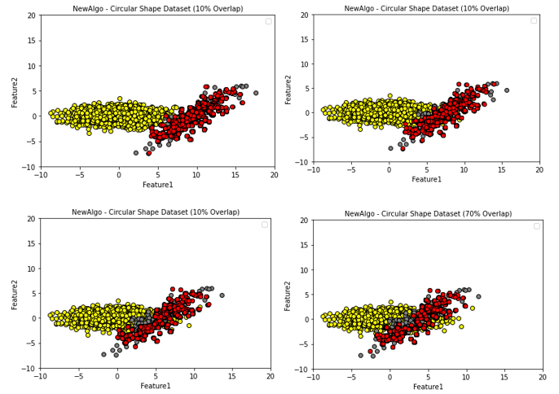
Experiment I
Experiment on Datasets with multiple degree of overlaps
Where the overlapping percentages are:
10% Overlapping
30% Overlapping
50% Overlapping
70% Overlapping

Slide 8
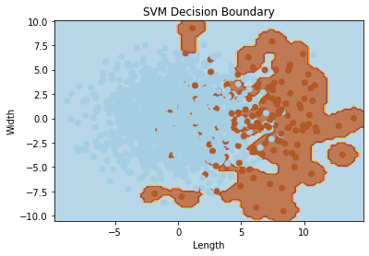
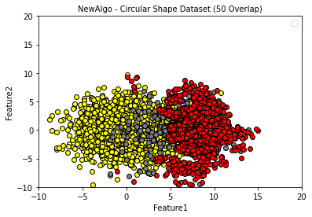
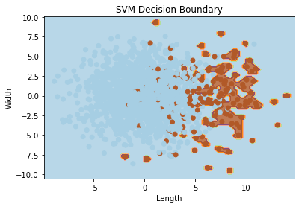
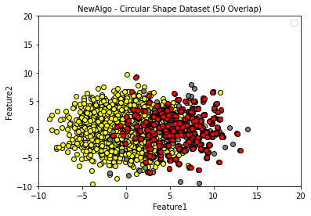
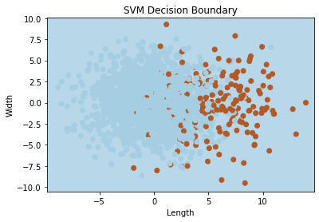
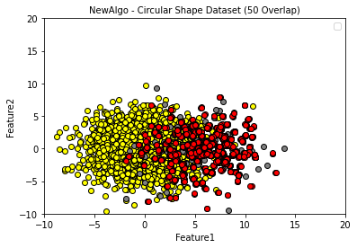

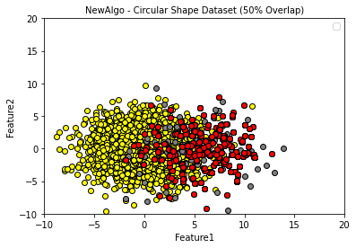
Experiment II
2. Modifying Hyperparameters (Gamma)
We used four Gamma values for this experiment:
Gamma 1
Gamma 50
Gamma 100
Gamma 500

Slide 9
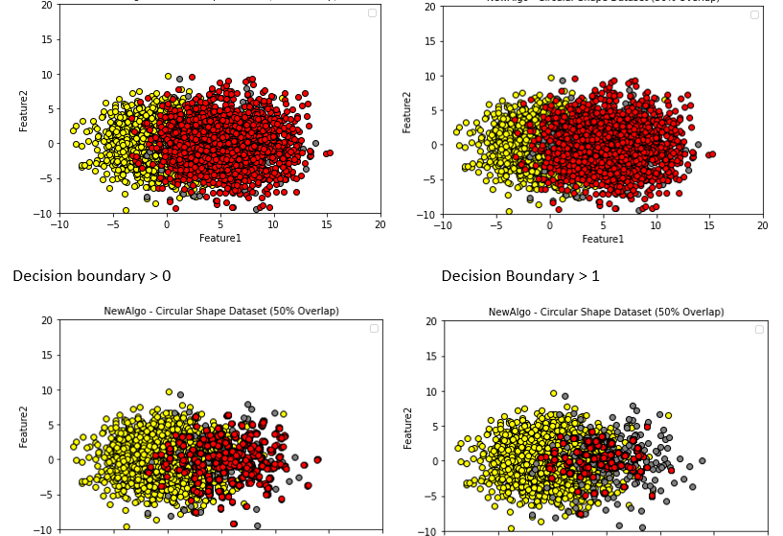
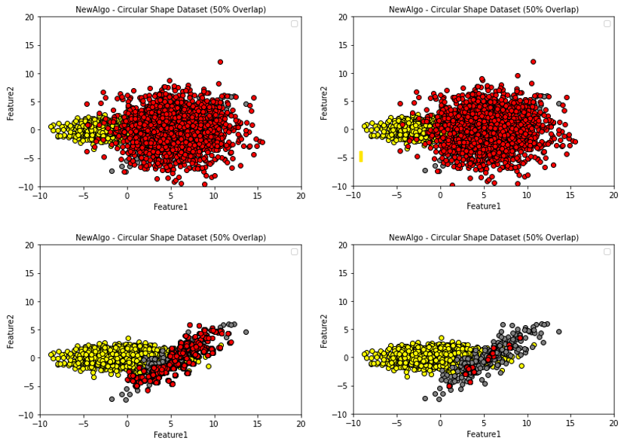
Experiment III
Modifying the Decision Boundary
Decision Boundaries Used
-2
-1
0
1
2

Slide 10
Conclusion
Flexible
Complex Datasets
Control
Compare SMOTE and ADASYN

